Slide 1
Introduction, Theory, History and Basics of Water Distribution System Modeling
Module 1
Introduction to EPANET Water Distribution Modeling
EWRI WORLD ENVIRONMENTAL AND WATER RESOURCES CONGRESS
June 5, 2018
Minneapolis, MN
Notes:
In this module, we are going to present an introduction, a brief history, and the theory behind water distribution system modeling. We will also introduce a hypothetical water distribution system called SmallWater USA that will be used as an example for most of our exercises. Before we start on the technical content of this course, we would like to do some introductions and present the logistical aspects of the course.

Slide 2
Curriculum
Module 1: Lecture on Introduction, theory, history, and basics of water distribution system modeling
Module 2: Hands-on demo of building and running a basic steady state model
Module 3: Lecture on Extended Period Simulation (EPS) and water quality modeling
Module 4: Hands-on demo of extended period simulation and water quality modeling

Slide 3
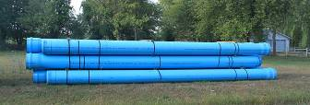

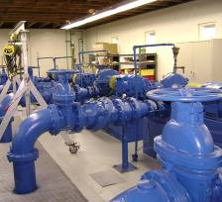
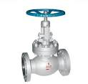
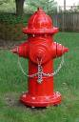
What is a Water Distribution System?
A collection of pipes, tanks, pumps, valves control systems and other appurtenances that together are used to move water from a water source or treatment plant to individual water users
Notes:
We will now proceed with the technical aspects of the module. Though I am sure that all of you know what a water distribution system is, here is a very concise definition of a water distribution system and its primary components.

Slide 4
Elements of a Water Supply System
Reservoir
Tanks
River
Canals &
Pipes
Pumps
WTP
Wells
Distribution System
Notes:
Water supply systems are composed of three major elements: (1) source waters (surface and groundwater) and the conveyance devices for storing and delivering raw water to a water treatment plant; (2) water treatment plants; and (3) the water distribution systems for delivering the finished water to the customers. Our course is devoted to modeling only water distribution systems.

Slide 5
What is a Water Distribution System Hydraulic Model?
It’s a computer program (software)
that takes as input
pipe network layout
water demands (consumption)
information on system operation
and produces as output
flows and pressures (heads) in the network
Steady-state: at a single point in time
Extended period simulation: at each time step
Notes:
A water distribution system hydraulic model is software that takes a set of input data describing the water distribution system and its operation and generates output on the estimated resulting flows and pressures in the system. There are two broad modes of operation of water distribution system models: steady-state models that generate a snapshot of the system at a single point in time; and an extended period simulation (EPS) model that looks at the results over a period of time. We will discuss both steady-state and EPS modeling in later modules.

Slide 6
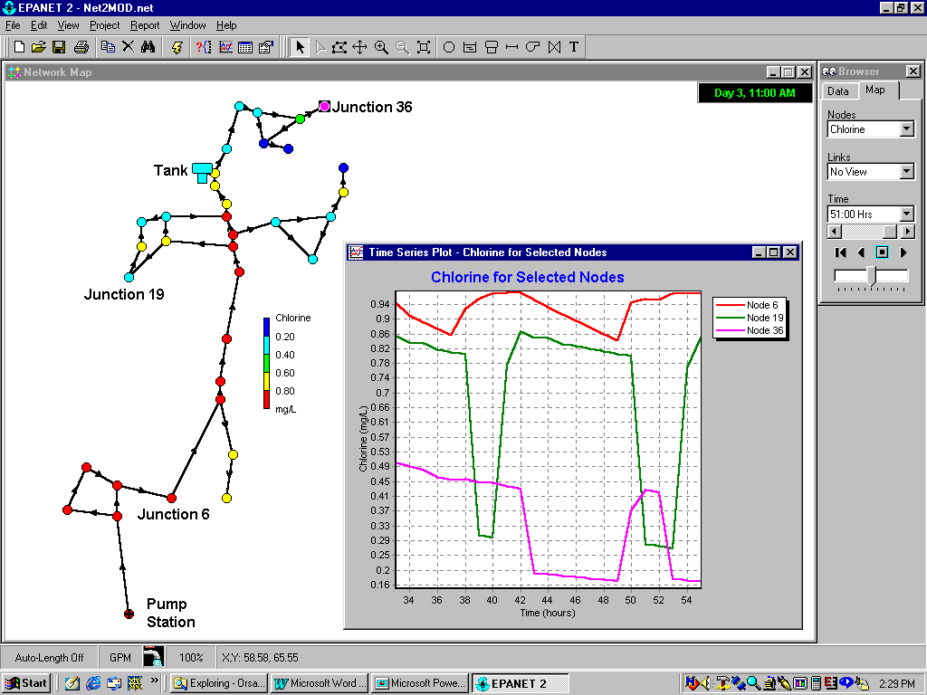
Notes:
Modern water distribution systems are built around graphical user interfaces (GUIs) for displaying both the input information used by the model and the results of applying the model. This figure shows the current EPANET GUI including both the map of the network and a time-series plot of modeling (water Quality) results. EPANET was the first Windows based water distribution system with a well designed GUI. There are two parts of the physical display: the Network Map which occupies most of the screen and the Browser located on the right side of the screen. There are also numerous secondary windows that pop up as party of the operation of EPANET. In this screen capture, a window conatining a plot that has been generated by the model is shown.

Slide 7


Model Input
Node
DEMAND (water use)
Length
Diameter
Roughness
Link
TANK
Elevation
Inflow (from source)
Quantity
Quality
Notes:
Water distribution system networks are represented by a connected link-node network. The link-node network may represent all pipes in the system (known as an all-pipe model) or a skeletonized representation of the network where only selected pipes are included. For example, the water system may be skeletonized to include all pipes greater than say 2” in diameter but exclude individual laterals connecting to customers or fire hydrants. A more severe level of skeletonization may only represent pipes with a diameter equal to or greater than 6”. As software becomes more powerful and run faster, and as GIS-based databases representing pipe systems become more available, the trend is to include more pipes in the model.
Nodes represent junctions, tanks and sources. Links represent pipes, valves and pumps. All demands (also called consumption and loads) are represented in the model as occurring at nodes.

Slide 8
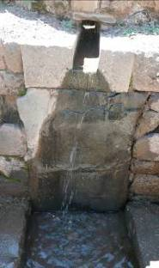
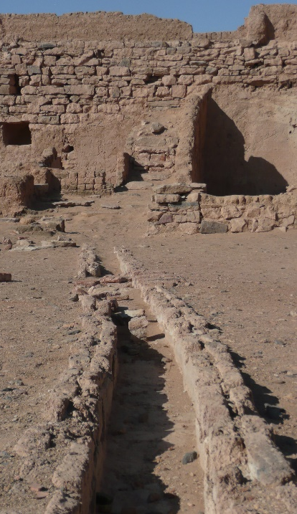

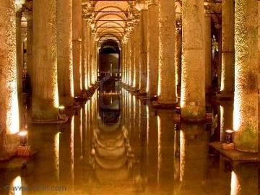
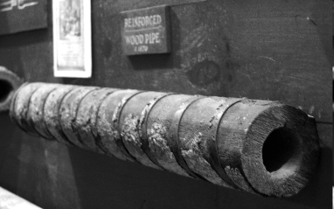
A Little History of Water Distribution
Notes:
It is always useful to know a little about the history of a subject. Water distribution systems date back several millennia. These pictures show systems in Turkey, Egypt and Peru dating back many centuries or even thousands of years. The wooden pipe was part of the Philadelphia water system in the early 19th century.

Slide 9
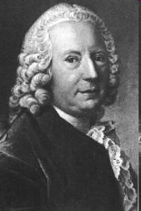
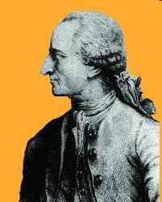
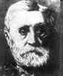
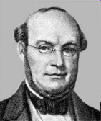
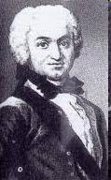
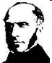
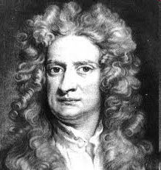
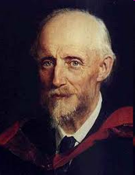
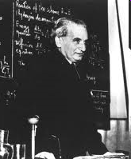

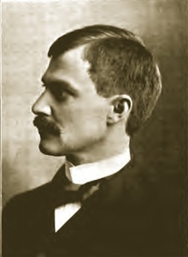
Pioneers of Water Flow Analysis
Darcy
Weisbach
Pitot
St. Venant
Bernoulli
Chezy
Reynolds
Hazen
Williams
Von Karmen
Newton
Notes:
Most of these pioneers are familiar to us from school. Grade schoolers have heard about a young Isaac Newton sitting in his garden when an apple falls on his head and, in a stroke of brilliant insight, suddenly comes up with his theory of gravity. Daniel Bernoulli’s (also son, brother and father of other famous scientists) research provided a basis for our understanding of fluid flow. We will hear more about Hazen and Williams, and Darcy and Weisbach and their contributions. Chezy, St. Venant, Reynolds and Pitot are all famous names in the area of water. And, Theodore von Kármán was truly a “rocket scientist” who contributed to our understanding of turbulent flow.

Slide 10
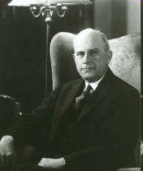
Hardy Cross
(1885 – 1959)
Notes:
The real beginning of water network modeling is associated with this publication written by Hardy Cross. Hardy Cross was a Professor of Structural Engineering at the University of Illinois. He is actually best known for the development of the moment distribution method for structural analysis of statically indeterminate structures. In the mid 1930s he developed what has become known as the Hardy Cross Method for analysis of flow in networks. This method is actually a derivative of his structural analysis method.

Slide 11

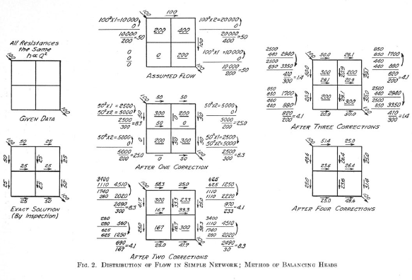
Notes:
The Hardy Cross method is “an iterative method for determining the flow in pipe network systems where the inputs and outputs are known, but the flow inside the network is unknown”. It is a very computationally intensive method. Did you use the Hardy Cross method in college? At the time it was developed and up until the 1960s, the actual calculations were done using a slide rule. Have you have used a slide rule? To quote Hardy Cross, his method “is an application of continuity of flow and continuity of potential to iteratively solve for flows in a pipe network”. In the case of pipe flow, conservation of flow means that the flow in is equal to the flow out at each junction in the pipe. Conservation of potential means that the total directional head loss along any loop in the system is zero. As illustrated, it is an iterative process where heads are balanced around the network. “The method of balancing heads uses an initial guess that satisfies continuity of flow at each junction and then balances the flows until continuity of potential is also achieved over each loop in the system”.

Slide 12
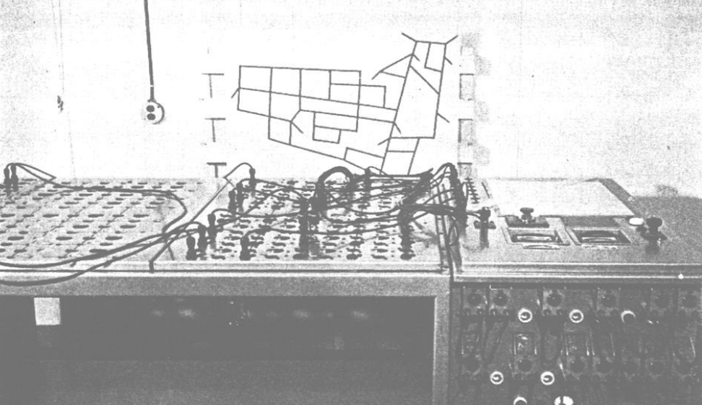
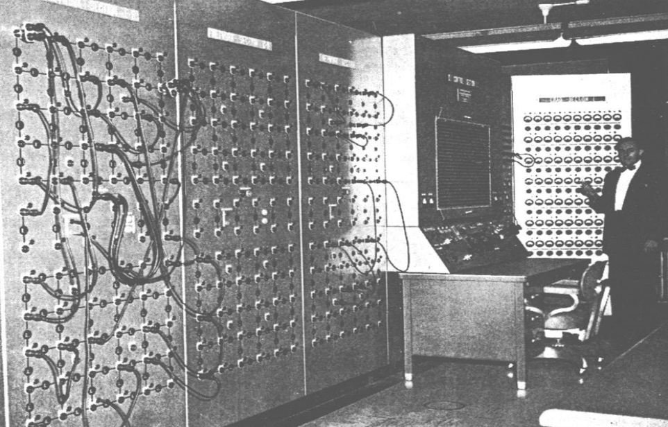
Analog Pipe Flow Analyzers
Thomas Camp’s analog system in the early 1940s
Malcom McIlroy’s analog nonlinear vacuum tube design in the late 1940s. This model was installed in Philadelphia.
Notes:
In the 1930’s and 1940’s before the advent of digital computers, several scientists experimented with analog systems composed of vacuum tubes, resistors and capacitors to simulate the flow of water in pipe networks. The picture on the bottom was a complex analog model of part of the Philadelphia Water System.

Slide 13
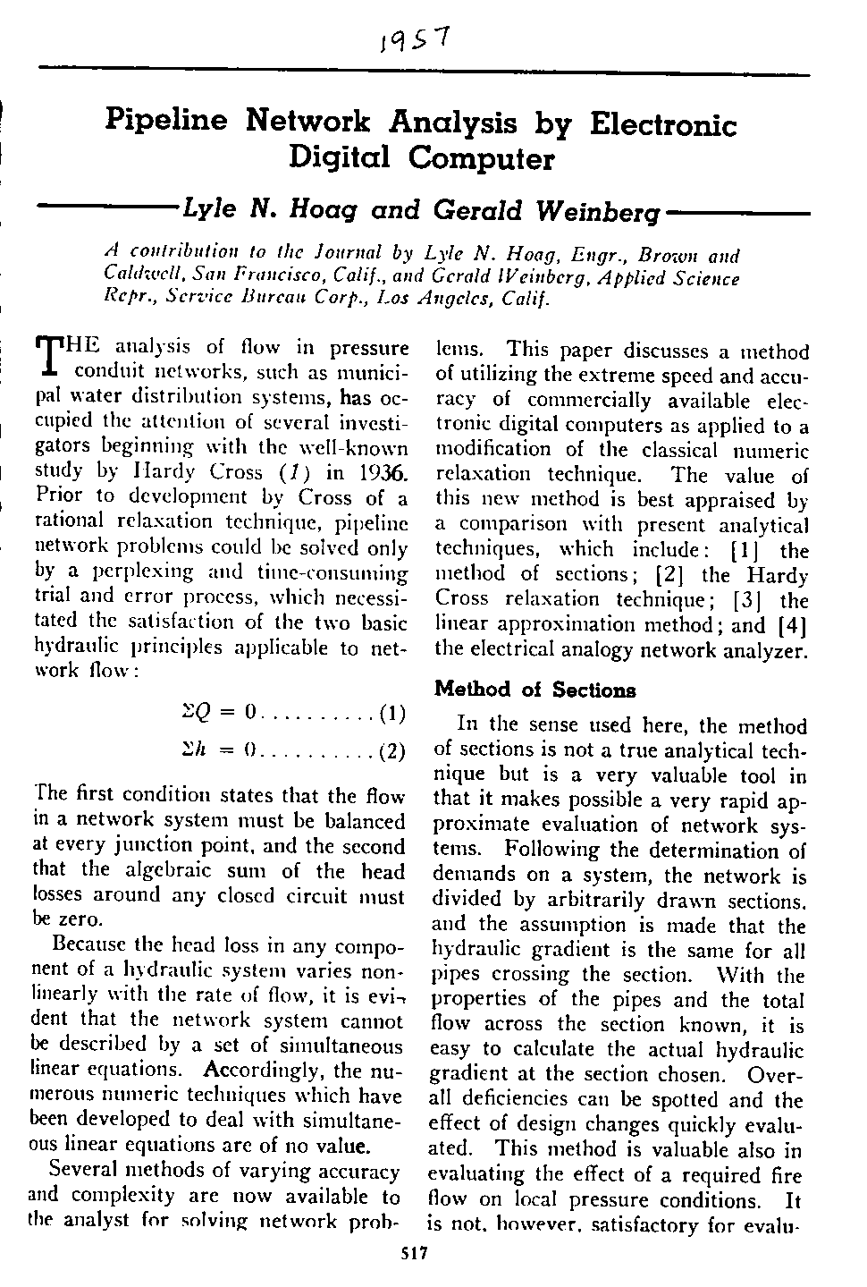
Early Computer Analysis (1957)
Notes:
Finally with the advent of digital computers in the 1950s, one of the first applications in the field of water was solutions to pipe network analysis. Given the tedious and limited nature of manual solutions of the Hardy Cross method, this development is not surprising.

Slide 14
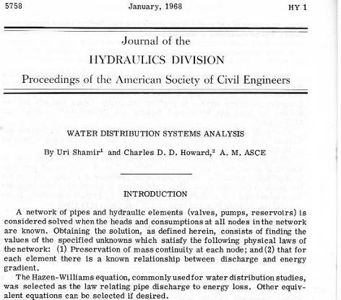


Steady-State Models
Network analyzed at a snapshot in time
No temporal variation
Notes:
In the 1960s, several researchers made advances in the field of water distribution systems analysis. Uri Shamir and Chuck Howard, classmates at MIT, developed one of the first widely accepted steady state solutions and used this model for analyzing flow in the Boston water system.

Slide 15
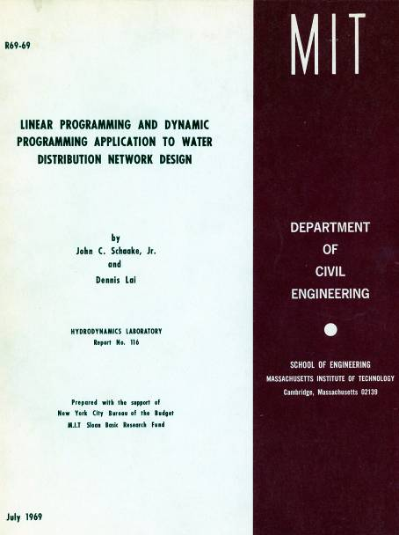
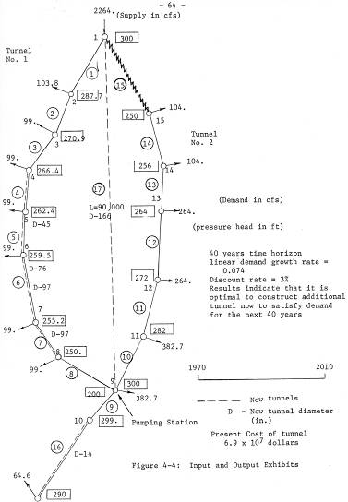
Optimization of Water System Design
Notes:
In the late 1960s, John Schaake and Dennis Lai, also at MIT applied optimization techniques (both linear and dynamic programming techniques) to determine the least cost piping solution for New York City’s planned tunnel to deliver water to Manhattan. This was the first in what is still considered an emerging technology for water system design.

Slide 16
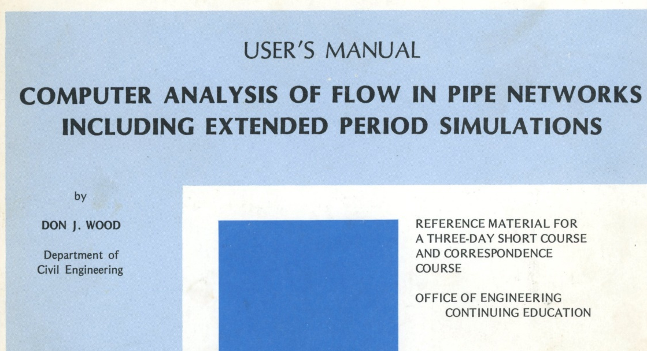
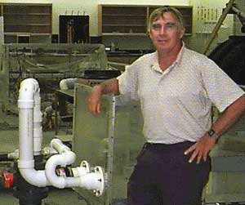
EPS Models
Extended Period Simulation (EPS) introduced in 1970s
Models distribution system over time as a series of linked steady state runs
First proposed by Don Wood (KYPipe)
Notes:
Don Wood of the University of Kentucky coined the term “EPS” in the 1970s and incorporated an EPS model in KYPIPE, one of the first software packages for distribution system modeling. EPS models actually represent a water distribution system over time by generating a series of steady state runs at a fixed time interval. If you want to learn more about Don Wood’s contributions to water modeling, go to the YouTube “Water Distribution Systems Analysis History Project” channel to hear an interview with Don Wood. There are also interviews with Uri Shamir and Chuck Howard and many other pioneers in this field on this channel.

Slide 17
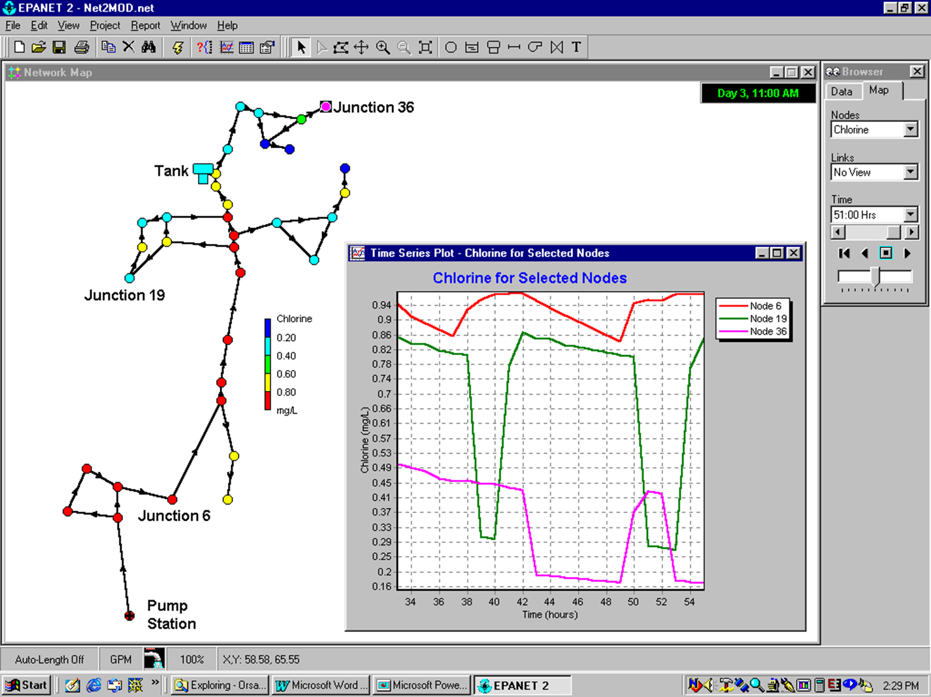

EPANET
Initially developed in 1993 by Lew Rossman
EPANET engine used in most commercial software packages
Version 2 in 2000: improved engine & features
New GIS-GUI version with improved functionality to be introduced in 2017 and beyond
Notes:
In 1993, Lew Rossman, an engineer at EPA, developed the first version of EPANET. EPANET was very important because (1) it was the first Windows-based software packages for water distribution system modeling, (2) it was available for free, and (3) the source code was freely available so users could actually make changes in the software. It was also used as the solver engine for most subsequent commercial software packages. In 2000, Dr. Rossman released EPANET Version 2 which greatly improved the performance of the model. A new GIS-based GUI for EPANET will be released by EPA in late 2017 or early 2018. Further improvements in EPANET are being made through an open source cooperative.

Slide 18
Hydraulics Review
Fundamental factors
Flow & Velocity
Pressure
Governing principles
Continuity
Energy
Headloss equations
Formulations and solution methods
Notes:
We sometimes refer to this as part of the course as pipe hydraulics 101. For those of you who are civil engineers, you probably studied this many years ago. We will be talking about:
The fundamental factors in pipe hydraulics: flow ,velocity and pressure
The two basic governing principles of continuity and energy
Empirical headloss equations
And a little on how pipe network models are formulated and solved.

Slide 19
Basic Assumptions about Flow
Software represents flow as:
Incompressible flow (not gas)
Turbulent flow (not laminar)
Closed pipe (not open channel)
Full pipe (no intermittent flow)
Newtonian flow
Single phase flow
Notes:
EPANET and most other hydraulic network software are designed to represent the following flow conditions:
Incompressible flow – you cannot use the software to model gas. Water is essentially an incompressible fluid since its volume does not change as pressure is applied.
Turbulent flow – cannot be used for laminar flow. For small (especially dead end pipes), you may run into very low velocities which may put you into the laminar phase.
Closed pipe – cannot represent open channel conditions which you occasionally run into in water systems.
Full pipe – does not allow partial flow conditions nor intermittent flow which is quite common in some developing countries.
Newtonian – Non-Newtonian flow like honey or ketchup cannot be represented. Typically we don’t model non-Newtonian flow conditions.
Single phase flow – Multiphase flow is not supported so you could not model liquid/solids flow such as water with a whole lot of solids. This is not an issue with drinking water (or even most sewage) that may have a small concentration of solids.

Slide 20
Common Units of Flow
English units (adapted for U.S.)
Gallons per minute (GPM)
Million gallons per day (MGD)
1 MGD = 646 GPM
Metric
Liters per second (l/s)
Cubic meters per second (m³/s)
1 m³/s = 1000 l/s
EPANET supports both units but we will use U.S. (English) units in this course
Notes:
Flow units can be expressed in English (U.S. units) or metric units. EPANET and most modeling software allow either sets of units. For this course we will emphasize U.S. units.
In U.S. units, flow is expressed most commonly as gallons per minutes (GPM) and million gallons per day (MGD). For larger systems, especially when dealing with treatment plants, flow is usually expressed in MGD. However, for smaller systems or smaller pipe flows, if you used MGD then you would be dealing with some very small and inconvenient values (e.g., 10 GPM = 0.015 MGD). It is certainly worthwhile to memorize the conversion factor that 1 MGD = 646 GPM.
For metric units, the most common flow units are liters per second (LPS) and cubic meters per second (m3/s). As is the case with most metric conversions, the conversion between these two units is much easier, i.e., 1 m3/s = 1000 l/s.
For conversion from U.S. to metric units, 1 GPM = 0.063 LPS or vice versa, 1 LPS = 15.85 GPM

Slide 21
Velocity
Velocity = Flow/Area (V = Q/A)
Area of a pipe is πD²/4 (D is pipe diameter)
V = 4Q/πD²
Common units:
English: feet per second (fps)
Metric: meters per sec (m/s)
Typical pipe velocities
Small neighborhood pipes (< 1 fps)
Transmission lines (1 to 4 fps)
Maximum velocities (10 fps)
Notes:
Velocity is simply flow divided by cross sectional area. Since we are much more familiar with pipe diameter, velocity can also be calculated in terms of flow and diameter.
One issue that we will discuss later in this course is what diameter we should use in calculating velocity, nominal or actual diameters.
The most common velocity units are feet per second in the U.S. and meters per second in metric units. Conversion between these two units are easy since we all know that 1 meter is equal to 3.28 feet.
We are sometimes asked what are typical pipe velocities in a distribution system and the proper answer is, “it depends”. For small residential pipes velocity is typically much less than 1 FPS under normal conditions. For transmission systems, we frequently see velocities in the range of 1 to 4 FPS. Why is there such a big difference? One of the primary reasons is that we design our piping systems to provide fire flow and as a result we effectively way overdesign our pipes in residential areas. Typically we will impose minimum pipe diameters of 6” or 8”. As a result, when flows are much lower as is the case in over 99% of the time, we see some very low velocities.
Maximum allowable velocities also can vary significantly. Typically communities will set maximums of 8 to 10 FPS, in order to reduce scour and to lessen headloss.

Slide 22
Pressure
Pressure = Force/Area
Typical units:
Pounds per square inch (psi) U.S.
Pascal (Pa) = Newton/ square meter. Metric
Normal range of allowable pressures
20 psi (minimum)
80 to 100 psi (maximum)
Notes:
Pressure is a measure of force per area. Typical units for pressure are pounds per square inch (PSI) in the U.S. and Pascals (newtons per square meter) in metric systems. In most water systems, the minimum allowable pressure is 20 PSI under fire flow conditions and something higher (30 to 40 PSI) under normal demand cases. Typical maximum allowable pressures are 80 to 100 PSI though higher pressure standards are sometimes needed in mountainous regions. Higher pressures can result in increased leakage or significant wear and tear on plumbing fixtures.

Slide 23
Pressure: psi to feet
How far will water rise for different pressures at the base?
115.5 feet
46.2 feet
2.31 feet
1 psi
20 psi
50 psi
Notes:
It is common to also think of pressure in terms of how far water will rise in a tube expressed in feet. Water will rise approximately 2.31 feet for each 1 PSI of pressure. As a result, a minimum pressure of 20 PSI will result in a rise of 46.2 feet.

Slide 24
Governing Principles Basic Laws of Physics
Continuity (Mass Balance)
Energy conservation
Q₁
Q₂
Q₁₂
1
2
Q₄₁
Q₂₃
4
3
Q₃₄
Q₄
Q₃
Notes:
There are two basic laws of physics that apply in network analysis, continuity (mass balance) and conservation of energy. To start to understand these principles, we show a single loop in a water distribution system. For those of you who have used the Hardy Cross method, you remember that this method proceeds iteratively in both preserving conservation of mass around loops while also conserving energy as you complete a circuit around a loop.

Slide 25
Continuity Equation (Mass Balance)
Q₁
1
Q₁₂
Q₁ + Q₄₁ – Q₁₂ = 0
or Q₁ + Q₄₁ = Q₁₂
Q₄₁
Notes:
Conservation of mass (and since flow is assumed to be incompressible, also conserving volume) is quite easy to understand. For junction #1, the flow entering the junction is equal to the flow exiting the junction either through pipes leaving the junction or water consumed at the junction (i.e., demands).

Slide 26
Energy Principle
In hydraulic analysis, we refer to Head as a measure of energy of water. Head is reported in units of length (feet in the U.S.).
Energy can take three forms:
Pressure head
Elevation head
Velocity head
Notes:
However, the energy principle is considerably more complex. First of all, when we do hydraulic analysis, we use the term “head” as a measure of energy and report head in units of length (feet in the U.S.).
Energy can take three forms in a network and when we consider all forms of energy we cannot create or destroy energy (i.e., conservation of energy). The three forms of energy are pressure head, elevation head and velocity head.

Slide 27
Hydraulic Grade Line
Head loss
Hydraulic grade line (HGL)
Pressure head (ft) = 2.31 p (psi)
Elevation head (ft)
Static head = Pressure head + Elevation head
Hydraulic grade line (HGL) connects static head points
Total head = Static head + velocity head
Notes:
Static head is the sum of pressure head and elevation head. If you connect all of the values of static head along a pipe or series of pipes you define the hydraulic grade line (HGL). Total head is the sum of the static head plus the velocity head. As we showed before, the difference between the static head and the total head is usually relatively small. When a tank is draining, the HGL slopes down as you move away from the tank. When a tank is filling, the HGL slopes down as you approach the tank.

Slide 28
Headloss Equations
Empirical equations describing headloss in a pipe or other means of conveyance.
Common methods for pipe headloss
Hazen Williams: Primarily used in U.S.
Darcy Weisbach: Rest of the world.
modified by Colebrook White and Swamee Jain
Minor headloss equations for fittings in pipes (e.g., bends, gates valves, etc.)
Headlosses associated with valves and pumps.
Notes:
Headloss equations describe the loss of head as water flows through a pipe. They are considered to be empirical relationships. This means that they were derived from experiments rather than derived from basic principles. There are many headloss equations that have been derived over the past few centuries. The most commonly used equation in the U.S. is the so-called Hazen Williams equation. In the rest of the world, the Darcy Weisbach equation is most commonly used equation. As we will discuss later, there are some approximations of the Darcy-Weisbach equations that simplifies the representations and solution of this equation. In addition to headloss in a straight pipe, there are so-called “minor” headlosses associated with fittings in pipe such as bends. There are also headlosses associated with pumps and valves.

Slide 29
Hazen Williams Equation
V = mean velocity (ft/sec)
C = Hazen Williams coefficient (decreases with increasing roughness)
r = hydraulic radius (feet) [area/wetted perimeter]
S = slope of energy line
h_{f}= head loss (ft)
Q = discharge (CFS)
L = length of pipe (ft)
D = inside diameter of pipe (in)
Equation of same form available for metric calculation
Notes:
This slides shows two forms of the Hazen Williams equation. Solution of this equation is quite easy.

Slide 30
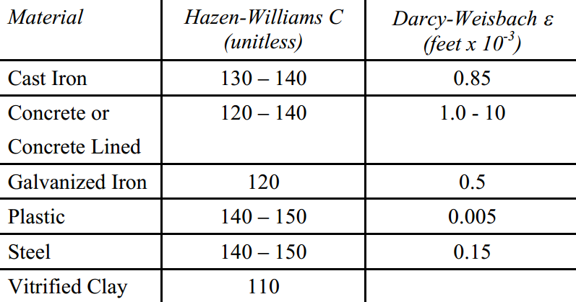
Typical Roughness Coefficients
For new pipes
EPANET 2 User’s Manual
As pipes age, coefficients change. For older pipes, Hazen-Williams roughness coefficient decreases and Darcy-Weisbach roughness coefficient increases
Notes:
This chart provides some typical values for the Hazen Williams C factor and the Darcy Weusbach roughness factors for new pipes. For older pipes, the Hazen-Williams roughness coefficient decreases and Darcy-Weisbach roughness coefficient increases. Though literature values for determining these coefficients in models for new pipes may be good estimates, for older pipes various field tests are useful in estimating these roughness coefficients. This is usually part of calibrating a model.

Slide 31
Formulations & Solutions
General formulation:
N Conservation of mass equations (linear)
L Conservation of energy equations (non linear)
Several different iterative, numerical solution techniques are available
Hardy Cross, Linear theory, gradient algorithm
EPANET uses the Todini gradient algorithm
Notes:
There are several different specific formulations for solving flow and pressure in pipe networks. However, they all come down to the fact that there are a set of N linear conservation of mass equations and L non-linear conservation of energy equations. Because of the non-linearity, a closed form solution is not possible and as a result, these set of equations must be solved iteratively. There are many mechanisms for solving this set of equations and many papers have been written comparing the advantages and disadvantages of each. EPANET uses the Todini Gradient Algorithm, a method that is widely acknowledged as a very good method.

Slide 32
Types of Hydraulic Models
Steady State (SS)
Snapshot of the distribution system at a given point in time
Could represent an average condition (e.g., average day), an extreme condition (e.g., peak hour), or at any point in time
Used for some fire flow analysis, design criteria, planning, etc.
Extended Period Simulation (EPS)
Time varying analysis, 24 hours or longer
Used for water quality, energy and many other types of analyses
Notes:
There are two types of hydraulic models; A steady state model represents the water distribution system at a given point in time i.e. maximum hour or maximum day are typical steady state representations of the distribution system. The Extended Period Simulation model or EPS model represents the water distribution system during a time varying period i.e. 24 hours or longer depending on what is trying to be analyzed. We’ll be focusing on Steady State analyses in this module in order to introduce you to model development. Module 6 will focus on EPS model development. In order to develop a Steady State model, one needs to know what point in time you are interested in analyzing. For example, a Maximum Day analysis might be needed in order to size a source, such as a Water Treatment plant along with storage reservoir sizing. We will not get into the details of developing demands in this module, except that average day demands are used in applying the base demand to the model and various peaking factors are used as multipliers to represent peak demands at various points of time in the model.

Slide 33



Representing a system as a link-node network
Links and nodes are generic names.
Pipes, pumps, junctions, tanks, etc. are specific types of links and nodes.
A link connects two nodes
The specified direction of a link depends on the specific type of link.
LINKS
Pipes
Pumps
Valves
NODES
Junctions
Tanks
Reservoirs

Slide 34
A detailed (complete) representation of network
LEGEND
Transmission line
Distribution line
Hydrant + lateral
Connection + lateral
A skeletonized representation of network

Slide 35
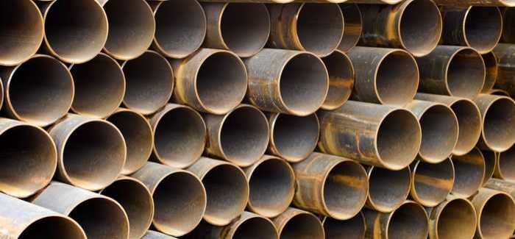
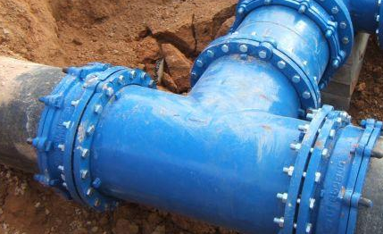
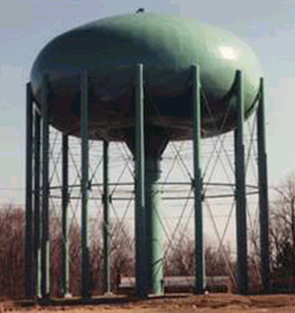
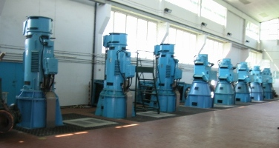
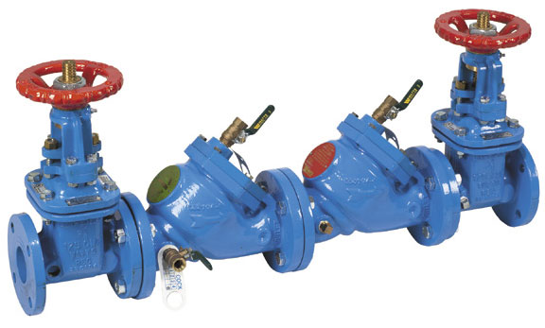
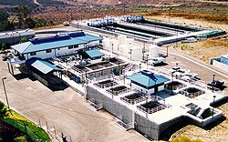
Major Components in a Water System
PIPES
JUNCTIONS
PUMPS
TANKS
VALVES
SOURCES
Notes:
I am sure that we have all seen examples of these six types of major components. These components can be very complex but in EPANET we represent them in a fairly straightforward mathematical manner. We will start in this module and talk about the two basic components in all water systems – pipes and junctions. Details of the other major components (pumps, tanks, valves and sources) and their representation in EPANET will be addressed in module 3.

Slide 36
Pumps
Pumps are links that impart energy to a fluid thereby raising its hydraulic head
A pump (head-flow) curve represents the relationship between the head and flow rate that a pump can deliver. Pump operates on a curve.
A pump efficiency curve shows the efficiency of a pump at different pump rates.
Notes:
Pumps are represented in EPANET as a link connecting an upstream node and a downstream node. All pumps are designed to impart energy into a water system at a particular location in the distribution system and as a result raise the hydraulic head from the upstream to the downstream node. Unlike a regular pipe link, pump links do not have a defined length.
How much flow does a 50 gpm pump actually deliver? The important answer is that it depends on the head against which the pump is pumping. As the head on the downstream side of the pump increases, the amount of flow that he pump can deliver decreases. A pump (head-flow) curve defines the amount if flow that can be delivered for different heads. The pump must operate on that curve. In EPANET, there are various ways to specify the shape of the pump curve. Pumps are typically designed to be most efficient at a specific pump rate. A pump efficiency curve defines the relationship between efficiency and pump rate.

Slide 37
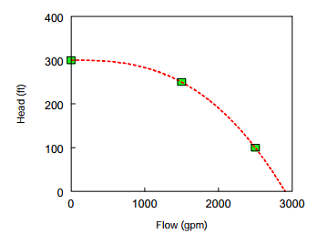
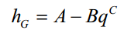
Three Point Pump Curve
Standard pump curve defined by:
Low Flow point (flow and head at low or zero flow condition),
Design Flow point (flow and head at desired operating point)
Maximum Flow point (flow and head at maximum flow).
EPANET fits a function of the form:
h_{G} = head gain
q = pump flow rate
A,B,C are constants
Notes:
The most common form for specifying a pump curve is the three-point method. The user defines three points – typically the low point, the design flow point (highest efficiency), and the maximum flow point. EPANET then fits a mathematical curve through these three points.

Slide 38
Pump Operation
Flow through a pump is unidirectional.
If system conditions require more head than the pump can produce, EPANET shuts the pump off.
If more than the maximum flow is required, EPANET extrapolates the pump curve to the required flow, even if this produces a negative head.
In both cases a warning message will be issued.
Notes:
In EPANET, a pump is represented in the following manners:
Flow through the pump can only be in one-direction
If the system requires more head than the pump can deliver then EPANET shuts the pump off (i.e., the pump must operate on the system head curve)
If more than the specified maximum flow is required, EPANET extrapolates the pump curve to the required flow, even if this results in a negative head.

Slide 39
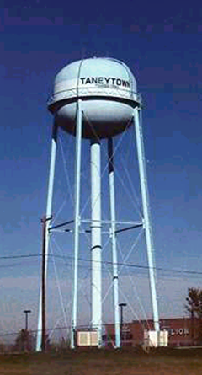
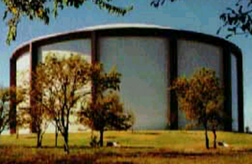
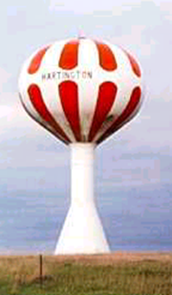
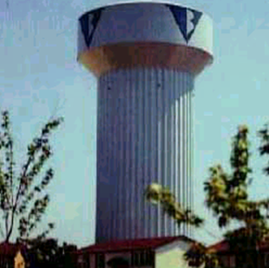
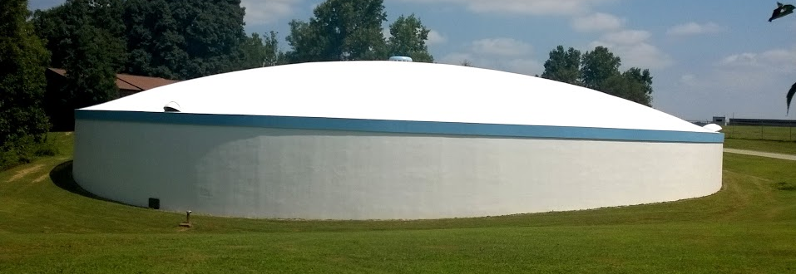
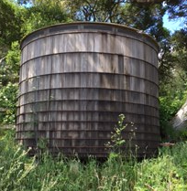
Tanks and Reservoirs
Tanks and reservoirs store water and provide head
They come in all shapes, sizes and configurations
Notes:
Tanks and reservoirs store water and provide head. They come in a wide variety of shapes, sizes and configurations ranging from a 5000 gallon redwood tank to a 2 million gallon elevated pedispheroid tank to a 25 million gallon in-ground rectangular reservoir.

Slide 40
What is the difference between a Tank & Reservoir?
In a water system?
Depends on local terminology
In a model?
There are a clear set of rules that differentiate the two.
A reservoir is of infinite volume and the water level does not change (a fixed grade node)
A tank has finite volume and the water level can change over time
In steady-state runs, tanks and reservoirs operate the same way with a fixed water level
Notes:
In your water system what is the difference between a storage unit is a tank or a reservoir?
Some people may say that a reservoir is larger and a tank is smaller. In other cases, people will say that if it is below ground then it is considered a reservoir and if it is above ground it is a tank. In other cases, people may say that it is a tank if it has regular sides while it is a reservoir if it has an irregular cross-section. I was surprised to find in California that a small (e.g., 5000 gallons) wooden storage facility is called a reservoir. So there is no correct answer and is based on local customs and terminology.
However, in an EPANET model there is a set of rules that control whether a storage facility is considered a tank or reservoir.
A reservoir is of infinite volume and the water level does not change
A tank has finite volume and the water level can change over time
In steady-state runs, tanks and reservoirs operate the same way with a fixed water level

Slide 41

Tank & Reservoir Characteristics
Elevated Tank
Diameter
Ground Level Tank
Required input values shown in bold red italics
Maximum
Level
Diameter
Minimum
Level
Initial
Level
Initial
Level
Reservoir
Total
Head
Elevation
Ground level
Elevation
Datum (e.g., msl)
Notes:
This diagram shows the characteristics of tanks and reservoirs as represented in EPANET. Elevated tanks and ground level tanks are represented essentially in the same manner with the one exception being how we define the tank bottom elevation: for a ground level tank the bottom elevation is the ground elevation above the datum point while for an elevated tank the bottom elevation is the bottom of the tank shell. Other required inputs for tanks are: the minimum, maximum and initial water levels, and the tank diameter (assuming a cylindrical tank). Special cases are discussed in the next slide. For a reservoir, the only required input is the total head which is the water level above the datum.

Slide 42
Valves
Valves are devices that limit the pressure or flow at a specific point in the network
Control valves are represented as links in EPANET with the following input requirements
Start and end nodes
Diameter
Setting
Fixed status (none, open, closed)
Some “special” valves are represented in different ways
Notes:
Valves are devices that limit the pressure or flow at a specific point in the network. In EPANET there are several types of valves: control valves such as pressure reducing valves and special valves such as check valves. For control valves, the user must specify the start and end node numbers, the valve diameter, the setting, and if there is a fixed status (open or closed) that does not change during the simulation. Special valves (check valves, shutoff valves and altitude valves are not represented as specific components in EPANET but are rather represented as characteristics of pipes or tanks. This will be discussed in more detail later.

Slide 43

Types of Valves in EPANET
Pressure Reducing Valve (PRV)
Pressure Sustaining Valve (PSV)
Pressure Breaker Valve (PBV)
Flow Control Valve (FCV)
Throttle Control Valve (TCV)
General Purpose Valve (GPV)
Check Valve
Shutoff Valve
Altitude Valve
Explicitly represented as control valves in EPANET
Represented in other ways in EPANET
Notes:
This slide shows the 9 types of valves represented in EPANET. The first 6 types are control valves. Control valves allow flow in only one direction (FROM node to TO node) while the last three are considered special valves. We will now explain the characteristics and representation of each of these types of valves.

Slide 44

Pressure Reducing Valve (PRV)
PRVs limit the pressure at the node downstream of the valve in the pipe network.
Setting for PRV is in terms of pressure
EPANET allows one of three different states for PRV:
partially opened (i.e., active) to achieve its pressure setting on its downstream side when the upstream pressure is above the setting
fully open if the upstream pressure is below the setting
closed if the pressure on the downstream side exceeds that on the upstream side (i.e., reverse flow is not allowed)
Example: SETTING = 50 psi DEMAND = 200 GPM
60
50
45
44
45
55
200 GPM
200 GPM
0 GPM
ACTIVE
OPEN
CLOSED
Notes:
Pressure reducing valves (PRVs) are probably the most common type of control valve in a water system. PRVs limit the pressure at the node downstream of the valve in the pipe network based on the user provided pressure setting. In an EPANET run, at any time, a PRV is in one of three states: active, open or closed. A PRV is active when it is partially open in order to limit the downstream pressure to the setting value. If the upstream pressure is below the setting, then the PRV is fully open. The downstream pressure is slightly less than the upstream pressure because of minor losses through the valve. If the pressure on the downstream side is greater than the pressure on the upstream side, then the PRV closes since it will not allow flow in the reverse direction.

Slide 45
Sources
Sources of water flow into the distribution system
Wells, treatment plants or transfers from other systems
There are no designated simple components to represent sources
Common ways of representing sources
Reservoirs with or without a pump (and other appurtenances)
Negative demands
Note that models must have at least one fixed grade node (tank or reservoir) to operate.
Notes:
A source is an entry point for flow into a distribution system. Examples of sources are water treatment plants, wells and transfers from other water systems. There is no simple “source” component. Rather a source is usually represented by a combination of components (e.g., reservoir, pump, flow control valve). A n alternative way to represent a source is as a negative demand. Note that models must have at least one fixed grade node (tank or reservoir) to operate.

Slide 46

Representing Wells
Composite element
Reservoir = groundwater level
Pump
Pipe losses
Surface node
Issue:
Actual pump creates a cone of depression when it is on
What do we use as the water level in reservoir in model?
Node
Pipe
Reservoir
Pump
Notes:
Wells are represented as a composite element. It can include the following elements: reservoir (set at the groundwater level), a pump, a pipe to introduce losses, a FCV, and a surface node.
What happens to the groundwater level when you turn a well on? The water level around the well drops to form a cone of depression. So what do you use as the groundwater reservoir level in the model? Either the reservoir level or the pump’s flow-head curve can be adjusted to represent the drawdown. However, it can get very tricky if there are multiple wells in close proximity where the cones of depression overlap.

